Slide 1
UNIT 3
CONTROL STRUCTURE

Slide 2

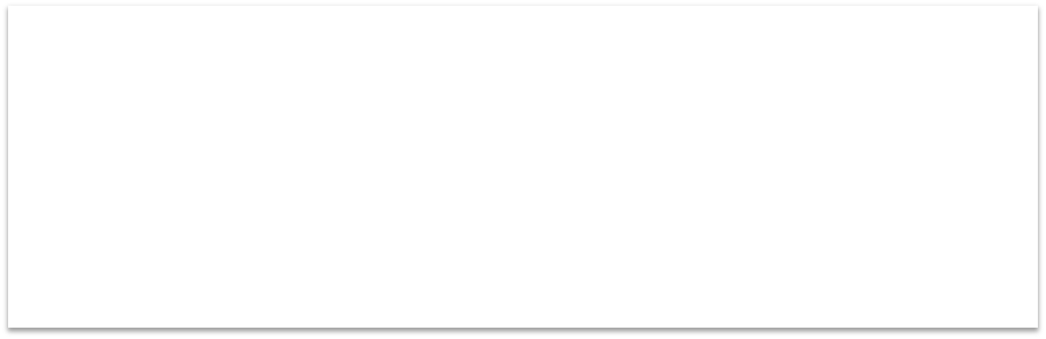


‘C’ Decision Making
Definition :
C program executes program sequentially. Sometimes, a program requires checking of certain conditions in program execution. C provides various key condition statements to check condition and execute statements according conditional criteria.
These statements are called as 'Decision Making Statements' or 'Conditional Statements'.
Followings are the different conditional statements used in C:
If Statement
If-Else Statement
If-Else-if Ladder/ladder if else
Nested If-Else Statement
Switch Case
Buy book Online - www.icebreakerspublications.com

Slide 3
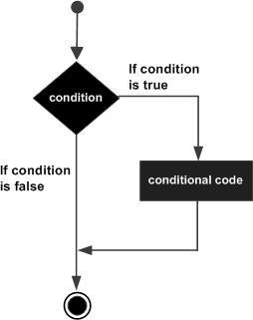
‘ if ‘ Statement
Syntax:
if(condition)
{
--
-- statements
--
}
Example:
if(x==10)
{
printf(“Hello ”);
}
Flow Chart :

Slide 4
if(x==10)
{
printf(“Hello ”);
}
#include<stdio.h>
#include<conio.h>
void main()
{
int x=11;
clrscr();
if(x ==10)
{
printf(“Hello ”);
}
}
o/p:-

Slide 5
‘ if else ‘ Statement
Syntax:
Flow Chart :
Example:
if (x==10)
{
y=x;
}
else
{
z=x;
}
if(condition)
{
--
-- statements
--
}
else
{
--
-- statements
--
}
Buy book Online - www.icebreakerspublications.com

Slide 6
WAP to check entered number is even or odd.
#include<stdio.h>
#include<conio.h>
void main()
{
int number;
clrscr();
printf(“\n enter the number:”);
scanf(%d”,&number);
if(no%2==0)
{
printf(“\n %d is even”);
}
else
{
printf(“\n %d is odd”);
}
getch();
}

Slide 7
WAP to check entered number is positive or negative
#include<stdio.h>
#include<conio.h>
void main()
{
int number;
clrscr();
printf(“\n enter the number:”);
scanf(%d”,&number);
if(no>0)
{
printf(“\n %d is positive”);
}
else
{
printf(“\n %d is negative”);
}
getch();
}

Slide 8
Ladder If else statment
It is used when there are multiple conditions to be checked.
It is a multiway decision making statement.
It is used to test set of conditions in a sequence.
If any of the given condition is satisfied then the related statements are executed and the control exists from the else if ladder.
It means further conditions are not going to be checked.
But if the condition does not satisfy then the compiler goes to next condition to check the condition.

Slide 9
Ladder if else statement
Syntax:
if(condition 1)
{
--
-- statements
--
}
else if(condition 2)
{
--
-- statements
--
}
Else
{
--
--
}
Other statements
Example:
if (marks > 79)
grade = "Honours";
else if (marks >59)
grade = "First division";
else if (marks >49)
grade = "Second division";
else if (marks > 39)
grade = "Third division"; else
grade = "Fail";
printf("%s\n", grade);

Slide 10
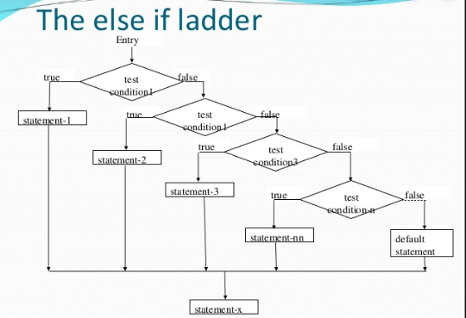

Slide 11
Nested ‘ if ‘ Statement
Syntax:
if(condition 1)
{
if (condition2)
{
--
}
}
Example:
if( a == 100 )
{
if( b == 200 )
{
printf("a is 100 and b is 200" );
}
}
Buy book Online - www.icebreakerspublications.com

Slide 12
Switch case statement
Syntax:
switch(expression)
{
case value-1 :
statement(s);
break; case value-2 :
statement(s); break;
default :
statement(s); break;
}
Example: int num=2; switch(num)
{
case 1: printf(“one”);
break;
case 2: printf(“two”);
break;
default:
printf(“bigger num”); break;
}
Buy book Online - www.icebreakerspublications.com

Slide 13



Looping
Definition :
There may be a situation when you need to execute a block of code several number of times. A loop statement allows us to execute a statement or group of statements multiple times.
Following are the looping statements in C language:
While loop
For loop
Do while loop
Buy book Online - www.icebreakerspublications.com

Slide 14
‘ While ’ Loop
Syntax:
while(condition)
{
--
-- statements
--
Increment/Decrement
}
Example:
int i=1; while(i<=2)
{
printf(“\nHello World”);
i++;
}
Output: Hello World Hello World
Buy book Online - www.icebreakerspublications.com

Slide 16
‘ For’ Loop
Syntax:
for ( init; condition; increment )
{
statement(s);
}
Example:
for (int i=1 ; i<=2 ; i++)
{
printf(“\nHello World”);
}
Output: Hello World Hello World
Buy book Online - www.icebreakerspublications.com

Slide 17
‘ Do While ’ Loop
Syntax:
do
{
--
-- body of loop
--
Increment/Decrement
}
while(condition);
Example:
int i=1; do
{
printf(“\nHello World”); i++;
} while(i<=2)
Output: Hello World Hello World
Buy book Online - www.icebreakerspublications.com

Slide 18

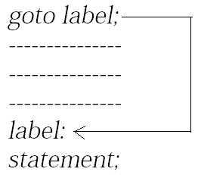
The goto Statement
Syntax:
Icebreakers-Publications.com 9975105542 , 9028747228
main( )
{
int i ;
for ( i = 1 ; i <= 100 ; i++ )
{
if ( i == 5 ) goto out ;
else
printf ( “\n %d ", i) ;
}
out :
printf ( "Out of the loop at last!" ) ;
}
Output: 1
2
3
4 Out of loop at last

Slide 19
The Continue Statement
Syntax:
Syntax:
continue;
Example:
{
int i, j ;
for ( i = 1 ; i <= 2 ; i++ ) //outer
{
for ( j = 1 ; j <= 2 ; j++ )
{
if ( i == j ) continue ;
printf ( "\n%d %d\n", i, j ) ;
}
//inner
}
}
Output: 12
21
Buy book Online - www.icebreakerspublications.com

